Slide 1
Hands-on Workshop on Introduction to Python
Day 01
Introduction and Installation

Slide 2
Acknowledgement
Before starting the workshop, we would like to thank ITER community and the department of ECE for providing this platform to organize the workshop.

Slide 3
Organizing Team
Instructors:
Dr. Kundan Kumar (E-139)
Dr. Sumanshu Agarwal (E-248)
Mr. Gyana Ranjan Patra (E-337)
Lab Supporting Staff:
Ms. Madhusmita Hota

Slide 4
Workshop Repository is Available at
https://github.com/erkundanec/Python_Workshop

Slide 5
Agenda of the Day
Installing Python
Python as Calculator
Running .py Script in Python
Starting with Jupyter Notebook
A Brief Introduction to Python
Variables and Tokens in Python
Starting Spyder (An IDE for Python)

Slide 6
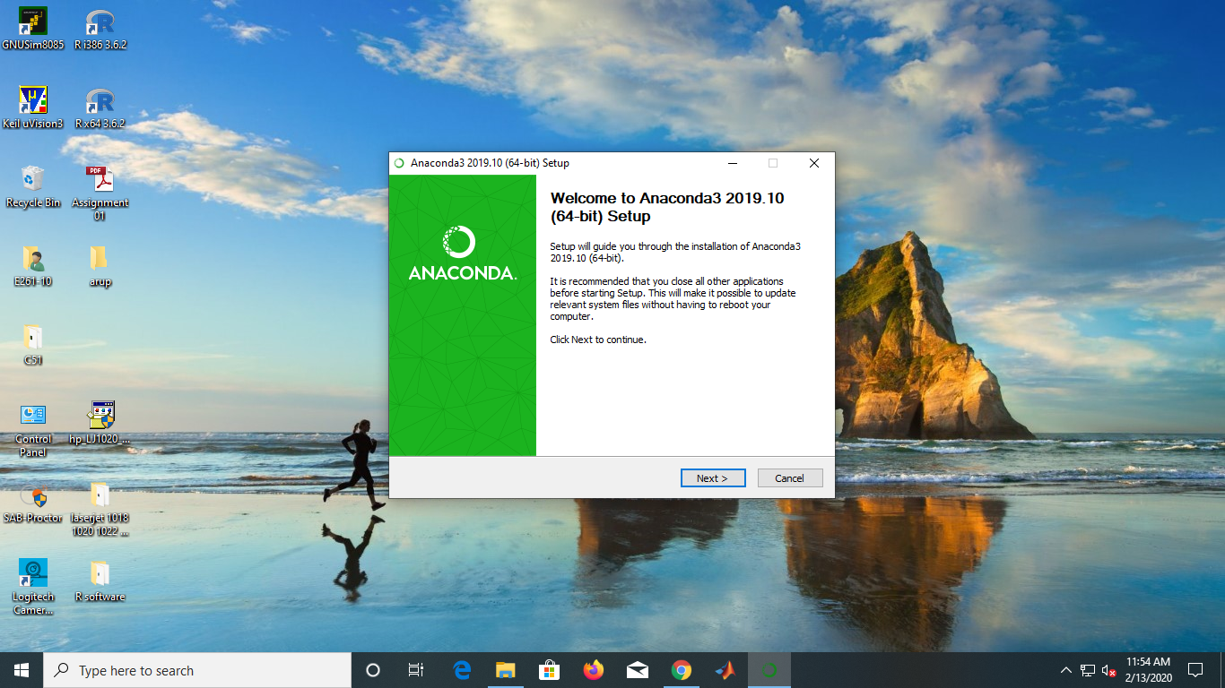
Installation of Anaconda

Slide 7
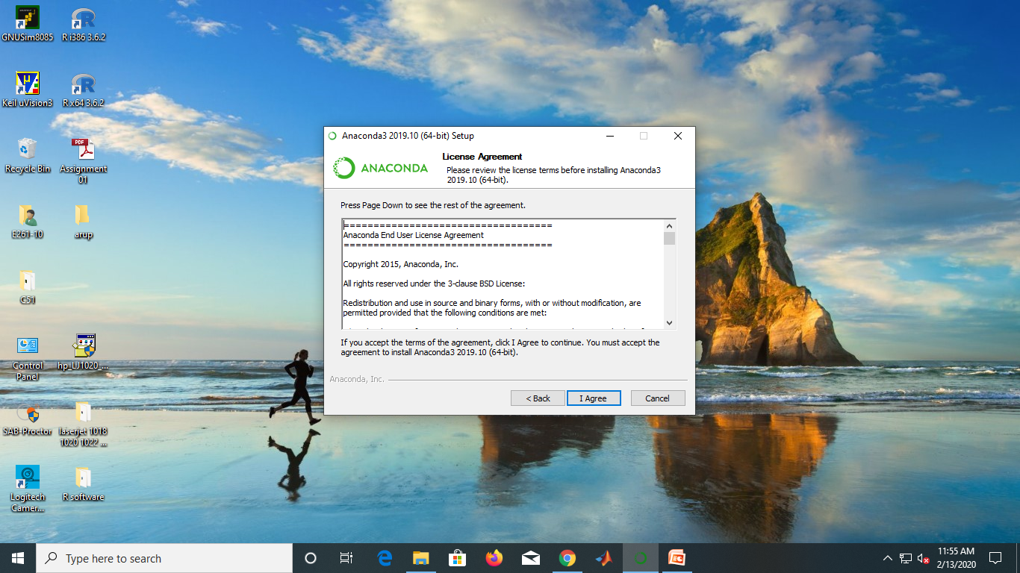
Installation of Anaconda

Slide 8
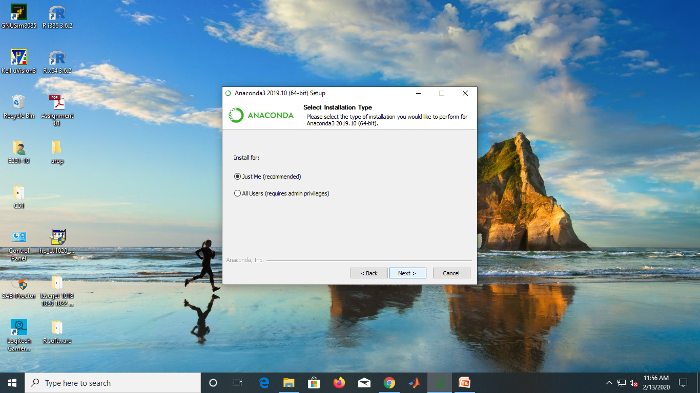
Installation of Anaconda

Slide 9
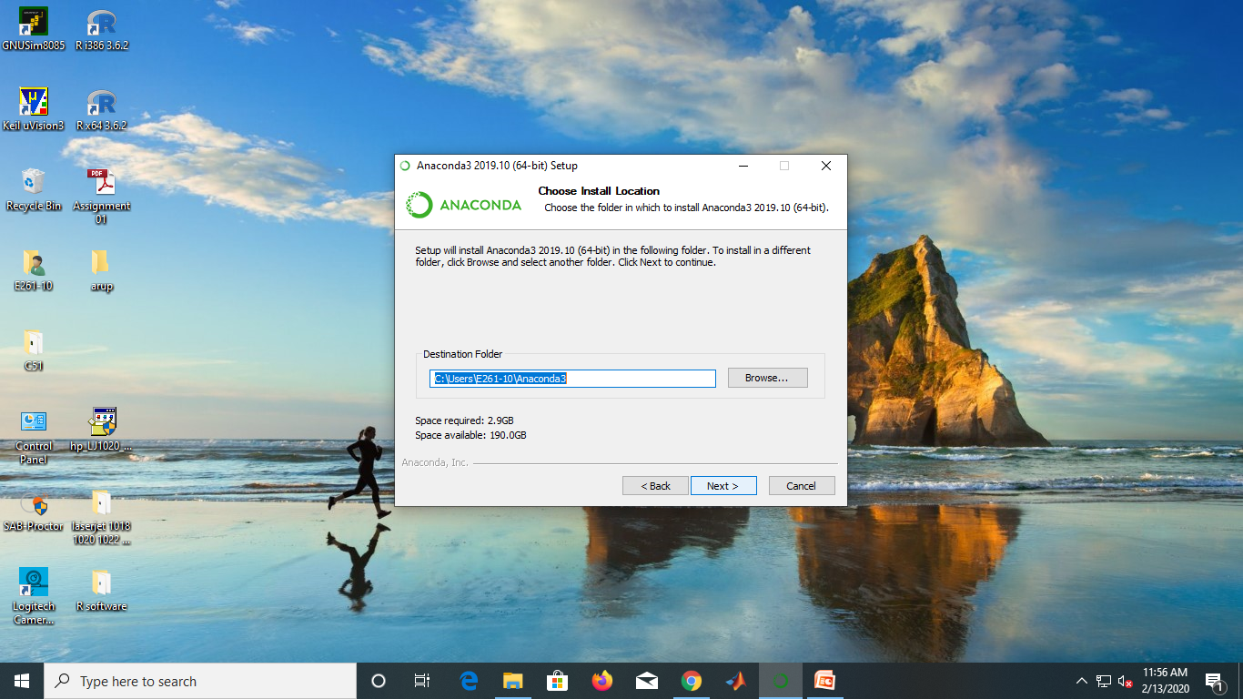
Installation of Anaconda

Slide 10
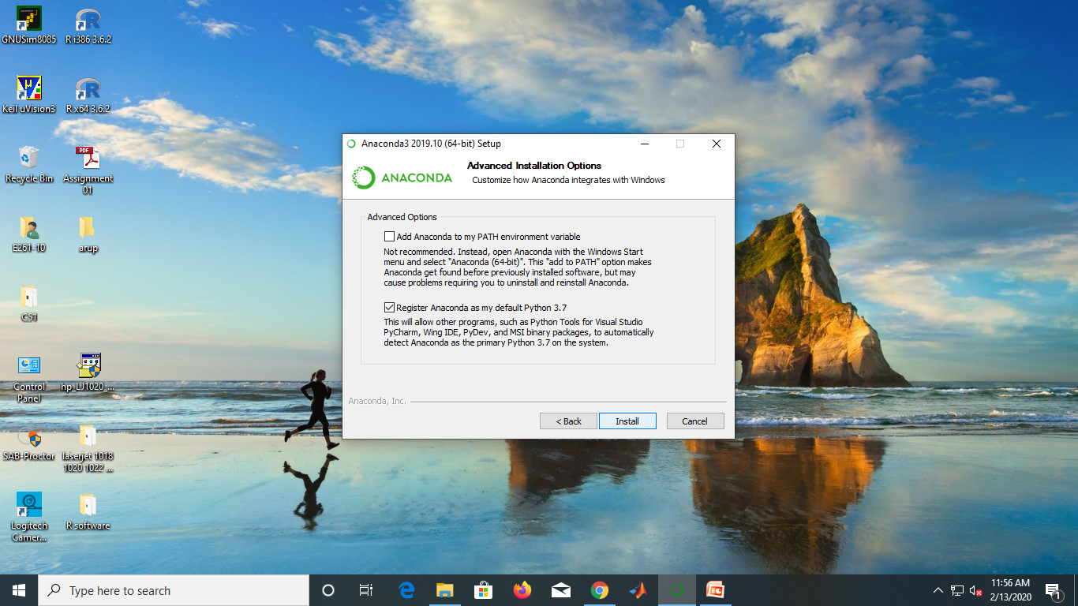
Installation of Anaconda

Slide 11
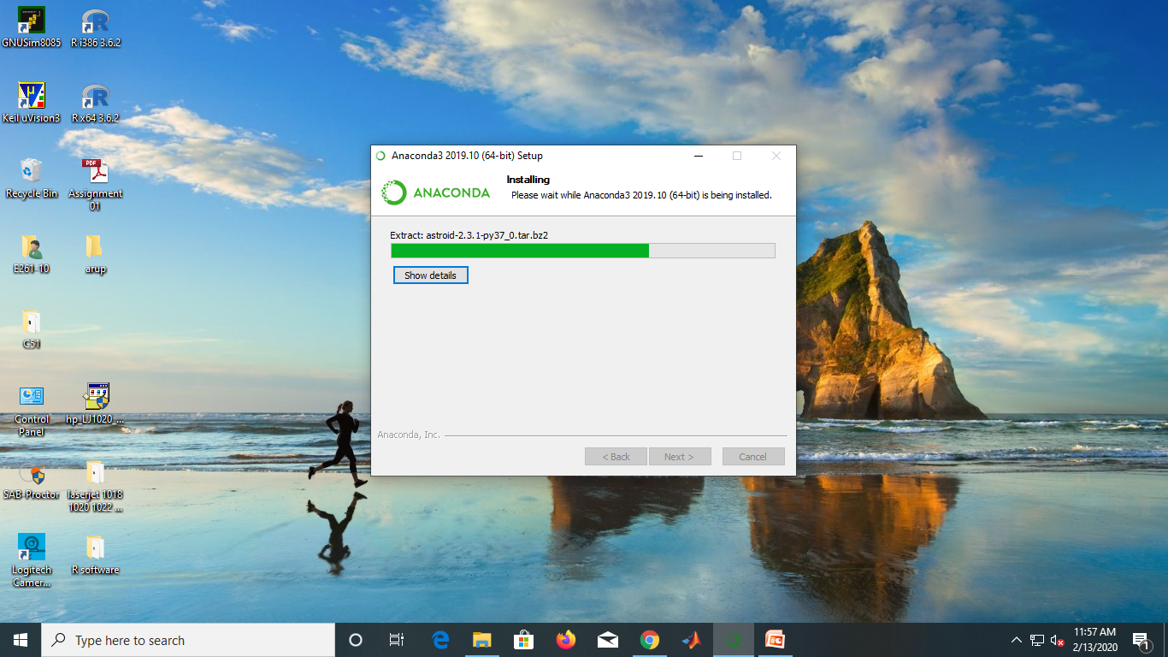
Installation of Anaconda

Slide 12
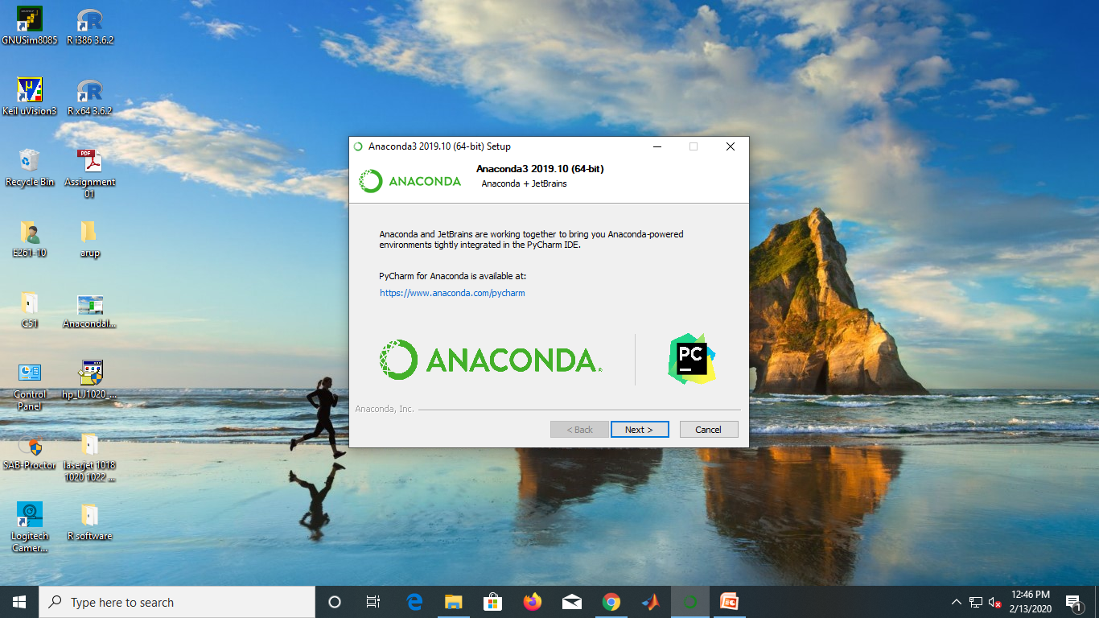
Installation of Anaconda

Slide 13

Installation of Anaconda

Slide 14
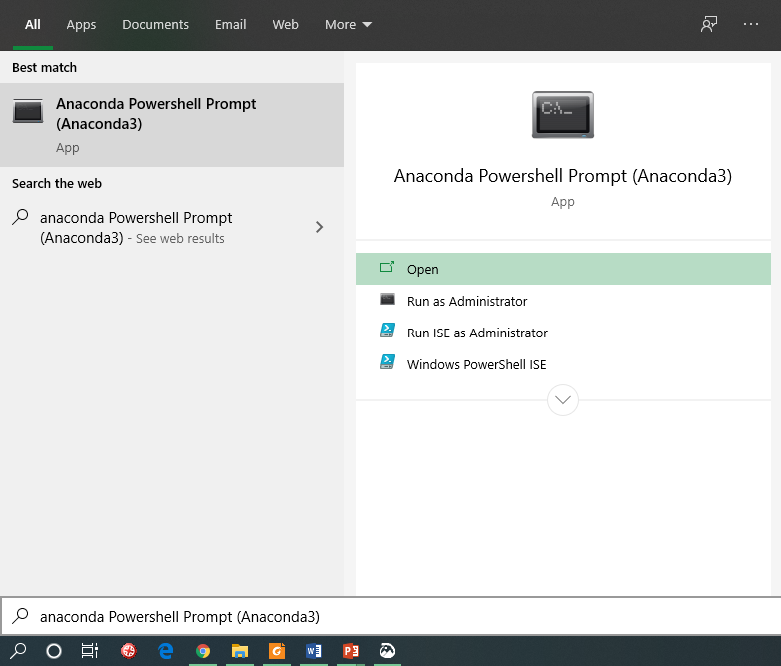
Starting Anaconda Powershell Prompt
Start it
Search for

Slide 15
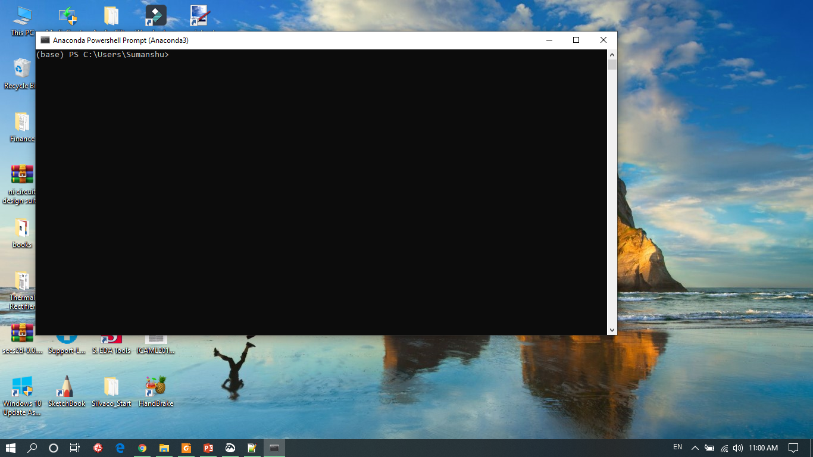
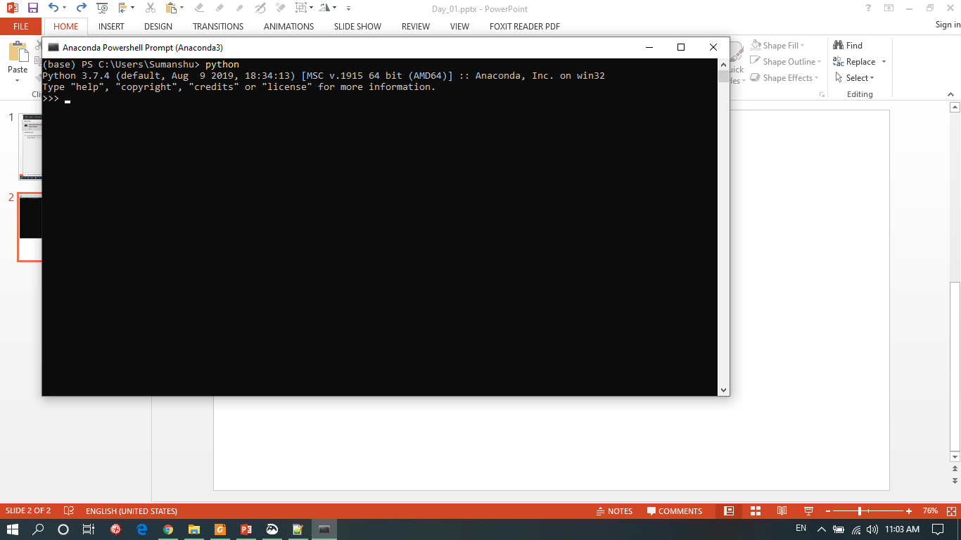
Starting Python Interpreter in Interactive Mode
Anaconda Powershell Prompt
Type in python and press enter

Slide 16
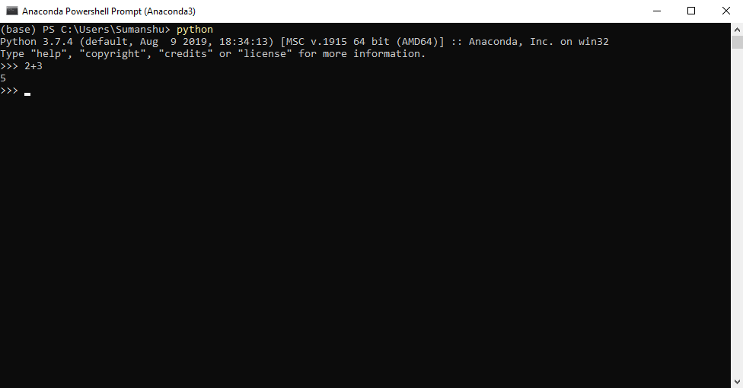
Python as a Calculator
Type in 2+3 and press enter
What is the output?

Slide 17
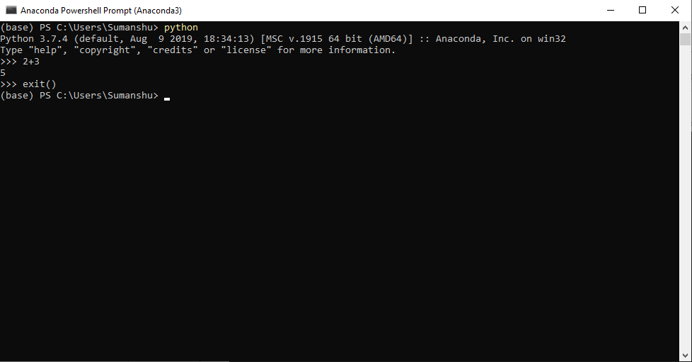
Shutting Down Python Interpreter
Type in exit() and press enter
What is the output?

Slide 18
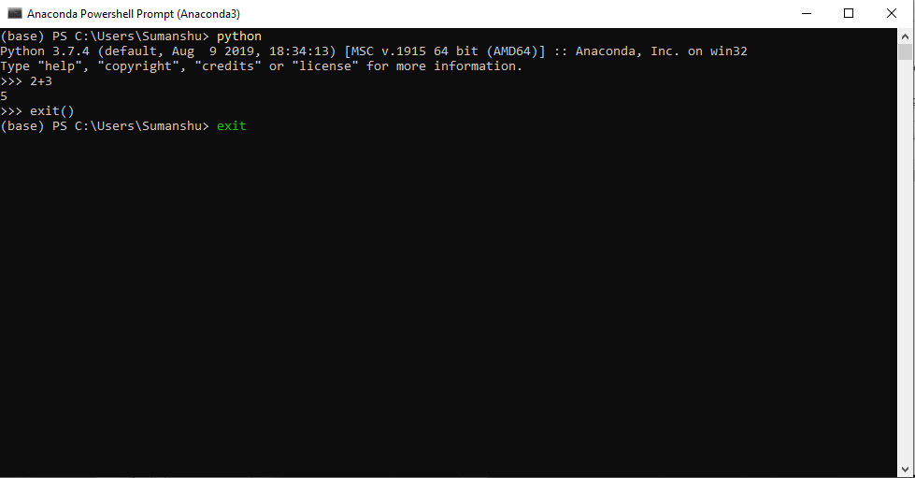
Shutting Down Anaconda Powershell Prompt
Type in exit and press enter
What happens?

Slide 19
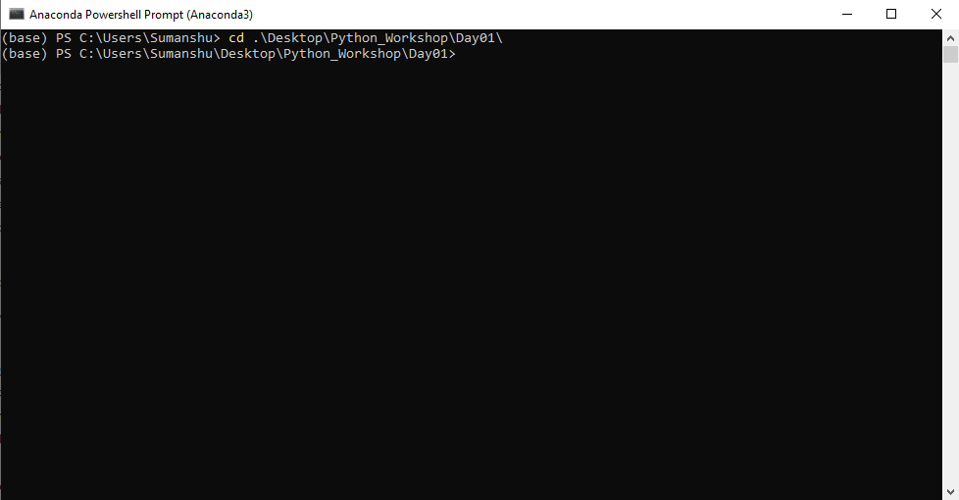
Changing Directory in Anaconda Powershell Prompt
Again open anaconda powershell prompt
Type in cd .\Desktop\Python_Workshop\Day01\ and press enter

Slide 20
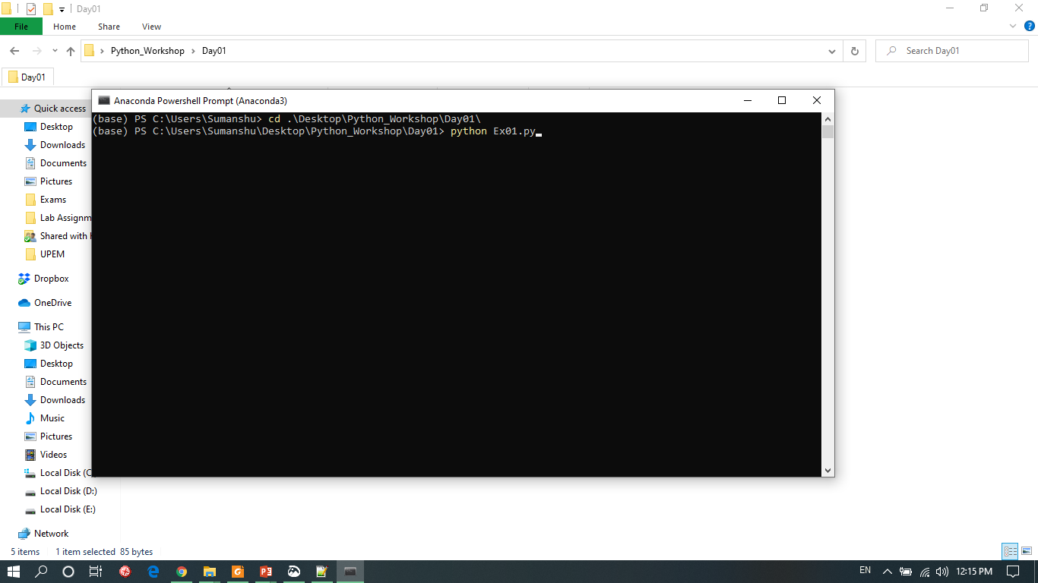
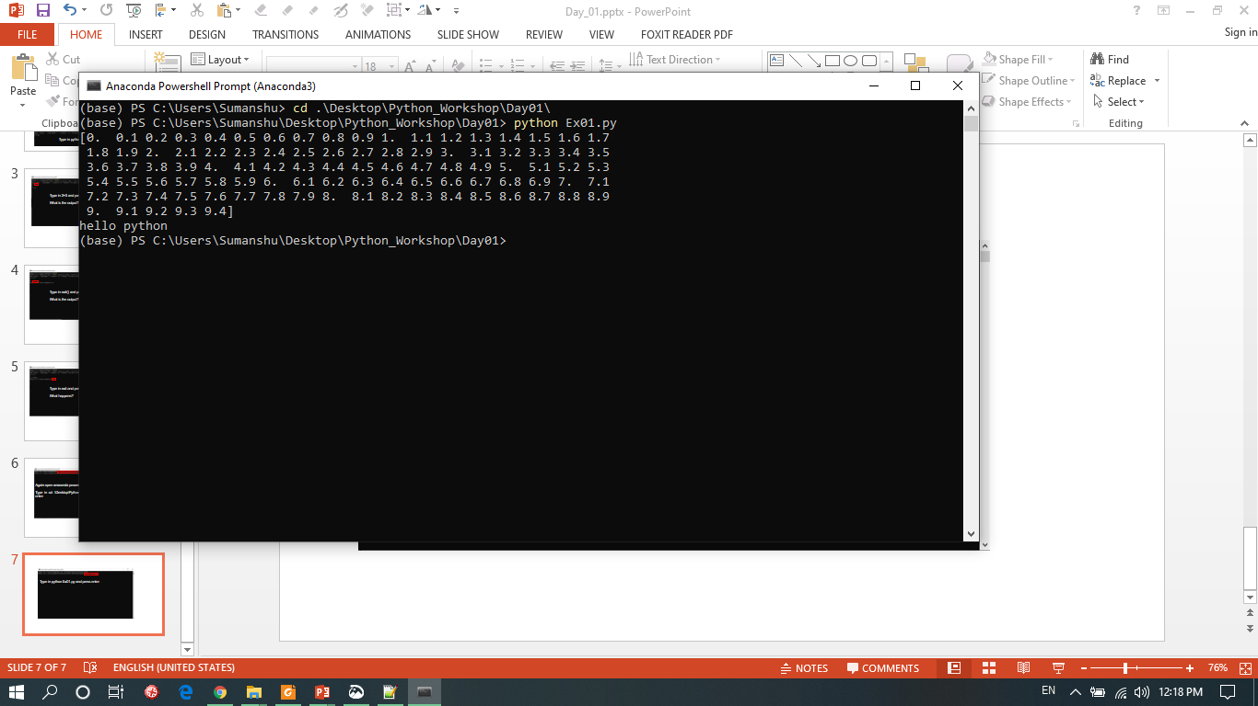
Executing Python Script in Anaconda Powershell Prompt
Type in python Ex01.py and press enter

Slide 21
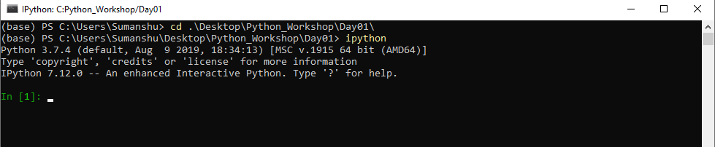
IPython Interpreter–An Alternative to Python Interpreter
open another anaconda powershell prompt
Type in cd .\Desktop\Python_Workshop\Day01\ and press enter
Type in ipython and press enter

Slide 22
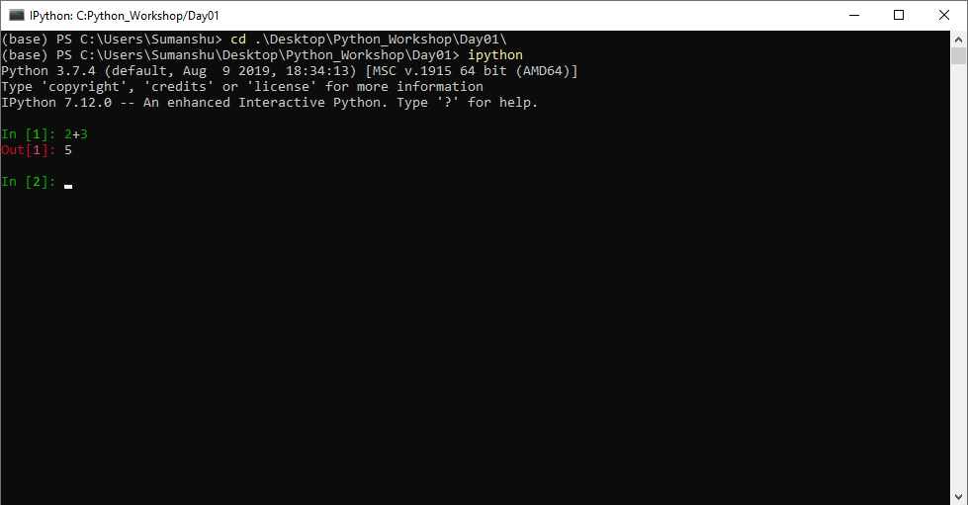
IPython as a Calculator
Type in 2+3 and press enter

Slide 23
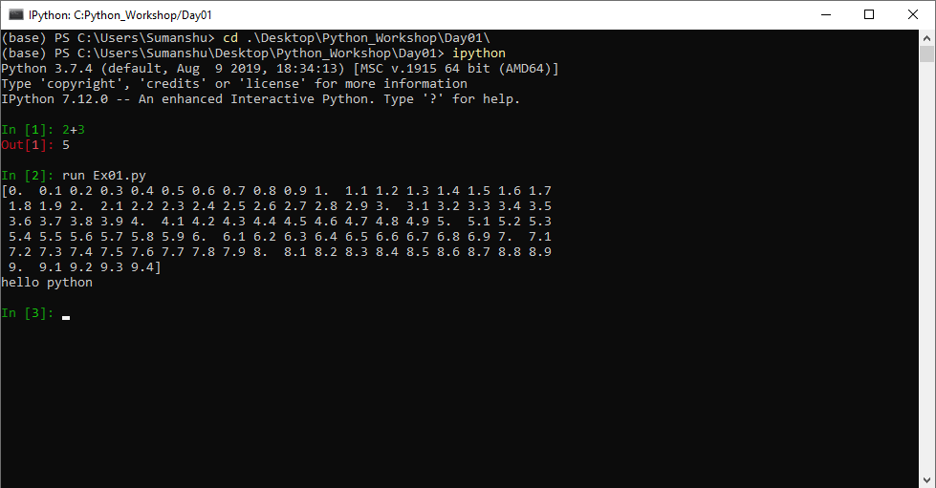
Executing Python Script in IPython
Type in run Ex01.py and press enter

Slide 24
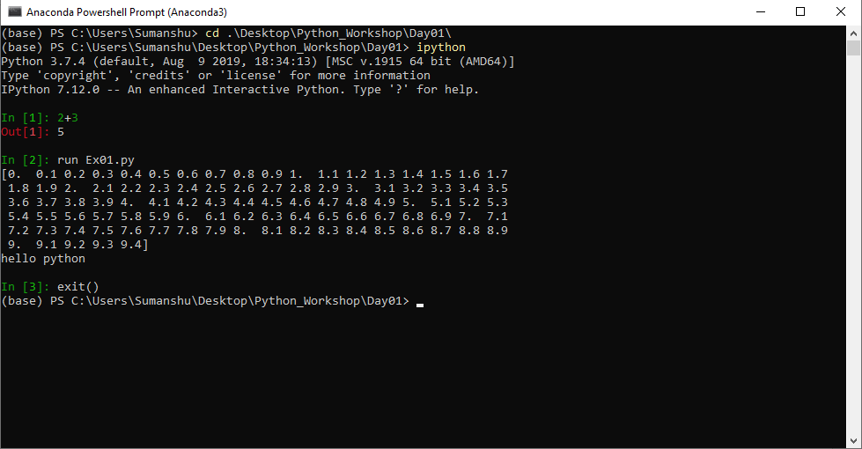
Shutting Down IPython Interpreter
Type in exit() and press enter

Slide 25
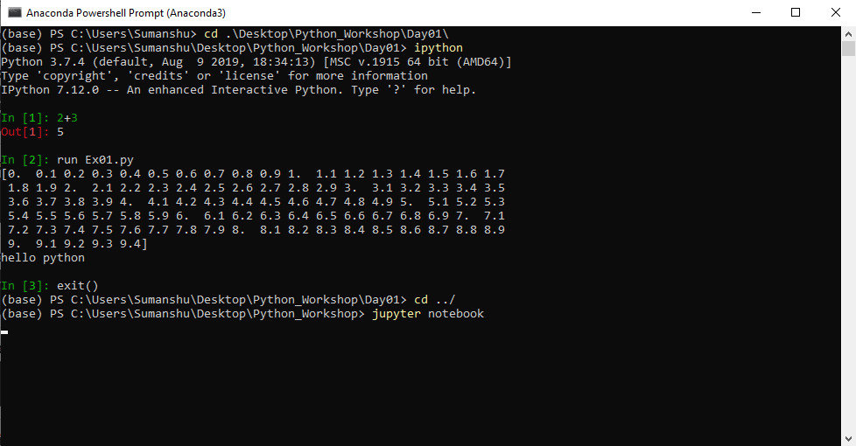
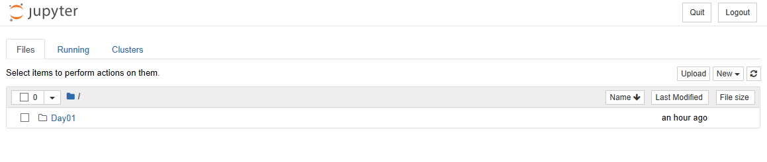
Jupyter Notebook
Type in cd ../ and press enter
Type in jupyter notebook and press enter

Slide 26
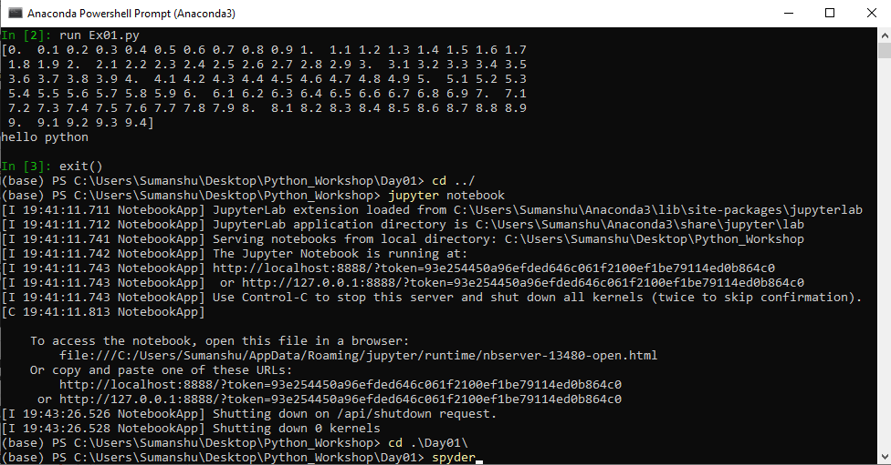
Spyder IDE
Type in cd .\Day01\ and press enter
Type in spyder and press enter

Slide 27
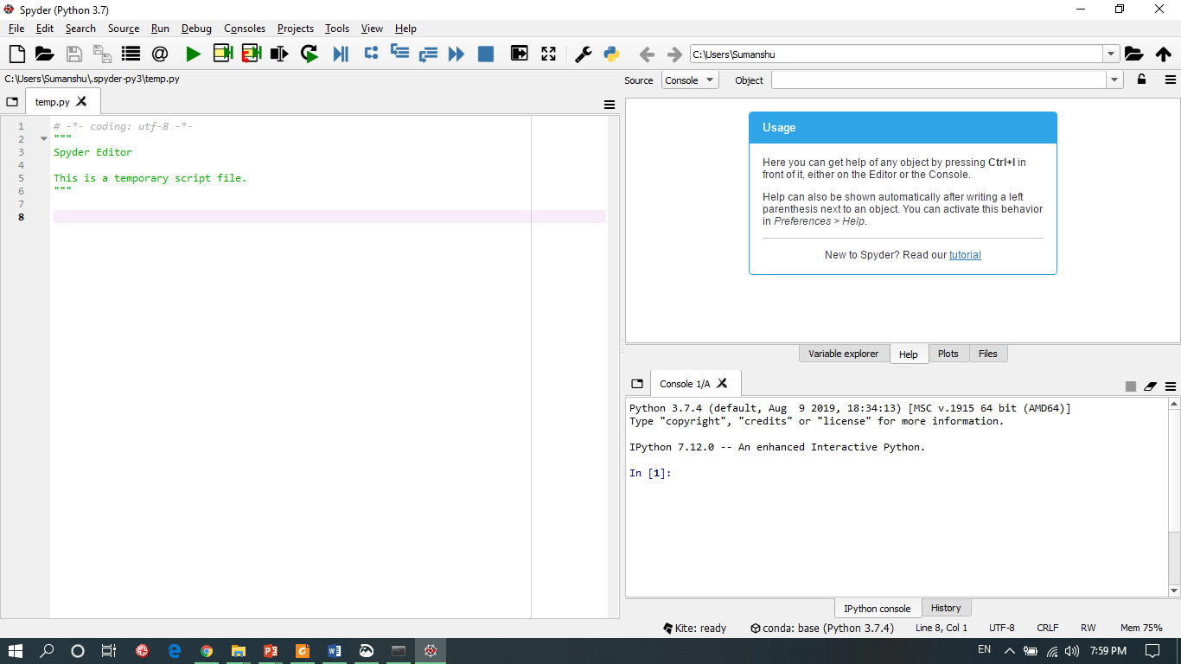
Spyder IDE
Object Explorer
Editor
IPython Console

Slide 28
Thank you

